Slide 1


Introduction to the Linked Data Platform (LDP) Hector Correa hjc14@psu.edu The Pennsylvania State University

Slide 2
Agenda
What is the Linked Data Platform (LDP)
Basic definitions of concepts and rules
Examples
Why this is important
Q&A

Slide 3
Related Sessions
Linked data, URIs, and labels by Trey Terrel
Introducing Hydra-works: PCDM in Hydra by Lynette Rayle

Slide 4
Linked Data
First introduced by Tim Berners-Lee in 2006
“The Semantic Web isn't just about putting data on the web. It is about making links, so that a person or machine can explore the web of data”
Identify things with valid URLs
Use standards for representation
Include other URLs in your data
See http://www.w3.org/DesignIssues/LinkedData.html

Slide 5
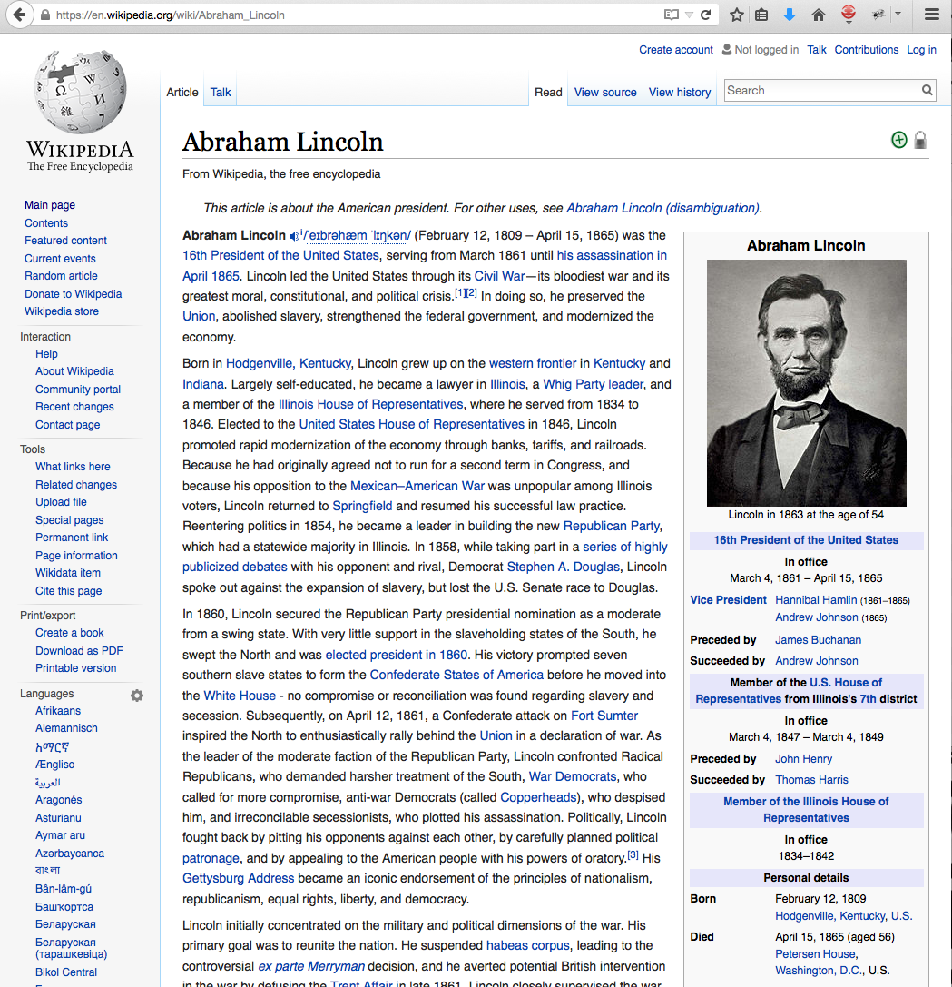
Birth place
https://en.wikipedia.org/wiki/Abraham_Lincoln

Slide 6
Linked Data
Abraham_Lincoln label "Abraham Lincoln” .
Abraham_Lincoln birthDate "1809-02-12” .
Abraham_Lincoln profession "Lawyer” .
[. . .]
Abraham_Lincoln birthPlace Hodgenville,_Kentucky .
http://dbpedia.org/resource/Abraham_Lincoln
http://dbpedia.org/resource/Hodgenville,_Kentucky
http://dbpedia.org/data/Abraham_Lincoln.n3

Slide 7
RDF 101
Resource Description Framework http://www.w3.org/TR/rdf-primer/
Data expressed in triples
<subject> <predicate> <object>
For example
<hydraconnect> <location> “Minneapolis”
<hydraconnect> <date> “2015-09-22”

Slide 8
From read-only to read-write
How are we supposed to update Linked Data
Intuitively we assume that we must use HTTP GET/POST and Resource Description Framework (RDF)…
…but what are the mechanics, the rules, how do we deal with containership

Slide 9
Linked Data Platform (LDP)
“defines a set of rules for HTTP operations on web resources, some based on RDF, to provide an architecture for read-write Linked Data on the web” http://www.w3.org/TR/ldp/
W3C Recommendation as of Feb/2015

Slide 10
Linked Data Platform (LDP) is an HTTP API for read-write Linked Data
API stands for Application Programming Interface.
An API defines the rules to communicate with a program.

Slide 11
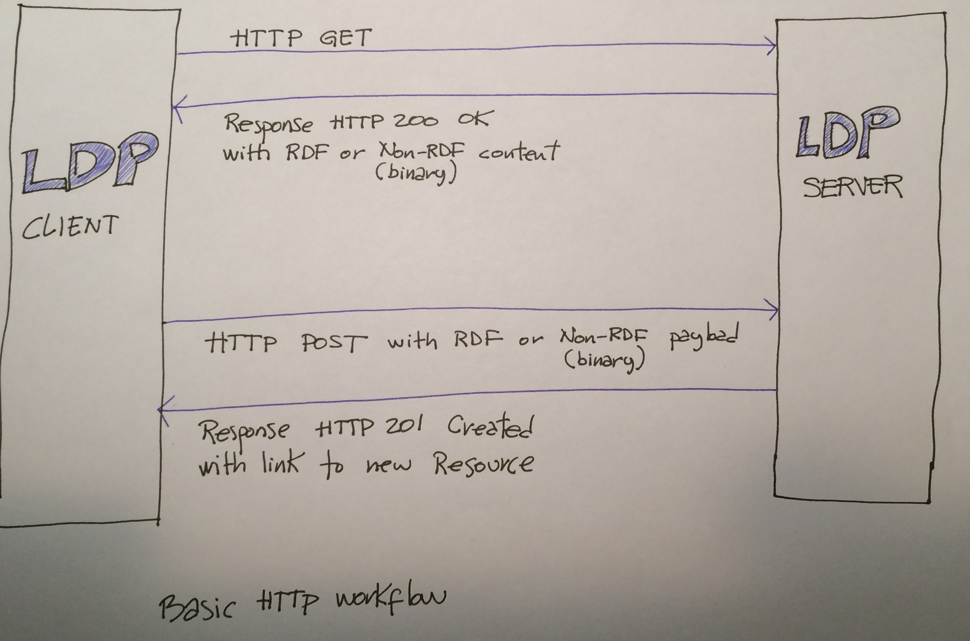
Basic HTTP workflow

Slide 12
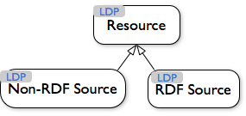
Concepts
Everything is a Resource
RDF Sources: expressed in Resource Description Framework (triples)
Non-RDF Sources: everything else (web pages, PDFs, image/audio/video files, binaries, et cetera)
http://www.w3.org/TR/ldp/

Slide 13
Create a New RDF Source
HTTP POST to create a
new RDF Source
(hydraconnect2015)
HTTP request
POST localhost/
Slug: hydraconnect2015
<> dcterms:title “Hydra Connect 2015”.
<> dcterms:subject “Hydra conference in Minneapolis”.
HTTP response
HTTP/1.1 201 Created
Location: http://localhost/hydraconnect2015/
Triples for the new resource
Yup, created…
…and here is the URL of the new resource

Slide 14
Fetch an Existing RDF Source
HTTP GET request
Client makes HTTP request
GET localhost/hydraconnect2015
Server returns HTTP response
HTTP/1.1 200 OK
Content-Type: text/turtle
Link: <http://www.w3.org/ns/ldp#BasicContainer>; rel="type”,
<http://www.w3.org/ns/ldp#Resource>; rel="type”
@prefix dcterms: <http://purl.org/dc/terms/>.
@prefix ldp: <http://www.w3.org/ns/ldp#>.
<localhost/hydraconnect2015/> a ldp:BasicContainer ;
dc:title “Hydra Connect 2015” ;
dc:subject ““Hydra conference in Minneapolis” .
RDF source that is a container
HTTP Headers
HTTP Body

Slide 15
Create a New Non-RDF Source
HTTP POST to create
a new Non-RDF Source
HTTP request
POST localhost/
Slug: logo.jpg
Content-Type: image/jpeg
Content- Length: 1020
[binary of the image goes here]
HTTP response
HTTP/1.1 201 Created
Location: http://localhost/logo.jpg
Binary data
…and here is the URL of the new resource

Slide 16
Show me the Graph
dc:title
hydraconnect2015
Minneapolis
September/2015
dc:subject
logo.jpg
Legend
Basic Container
logo.jpg
Added by LDP Client

Slide 17
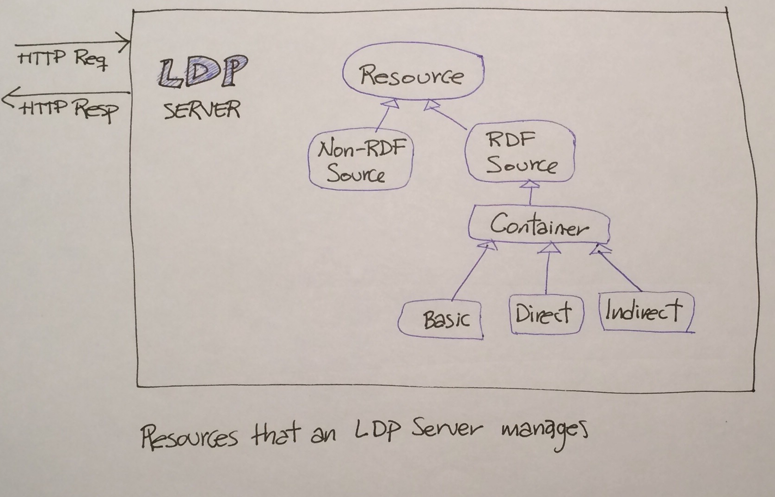

Concepts (expanded)
http://www.w3.org/TR/ldp/

Slide 18
Adding an RDF Source to a Basic Container (1/2)
POST to Basic Container
HTTP request
POST localhost/hydraconnect2015/
Slug: session1
<> dcterms:title “Welcome to Hydra Connect 2015”.
<> dcterms:subject “blah blah”.
HTTP response
HTTP/1.1 201 Created
Location: http://localhost/hydraconnect2015/session1

Slide 19
Adding an RDF Source to a Basic Container (2/2)
Fetch the Basic Container
HTTP request
GET localhost/hydraconnect2015/ HTTP/1.1
HTTP response
[the usual HTTP headers go here]
<localhost/hydraconnect2015/> a ldp:BasicContainer ;
dc:title “Hydra Connect 2015” ;
dc:subject ““Hydra conference in Minneapolis” ;
ldp:contains <localhost/hydraconnect2015/session1> .
New triple automatically added by the LDP Server

Slide 20
Show me the Graph
ldp:contains
dc:title
Welcome to Hydra Connect
session1
dc:subject
Hi Everybody
dc:title
hydraconnect2015
Minneapolis
September/2015
dc:subject
Legend
Basic Container
Direct Container
Added by LDP Client
Added by LDP Server

Slide 21
Direct Containers (1/2)
HTTP request
POST localhost/ HTTP/1.1
Slug: speakers
<> dcterms:title “People that speakers at conferences”.
<> rdf:DirectContainer .
<> ldp:membershipResource <localhost/hydraconnect2015> .
<> ldp:hasMemberRelation hasSpeaker .
HTTP request
POST localhost/speakers HTTP/1.1
Slug: janedev
<> dcterms:title “Jane Developer”.
Create Direct Container
Containership
Add new resource to it

Slide 22
Direct Container (2/2)
The membershipResource…
HTTP request
GET localhost/hydraconnect2015
HTTP response
[bunch of HTTP headers go here]
<localhost/hydraconnect2015/> a ldp:BasicContainer ;
dc:title “Hydra Connect 2015” ;
dc:subject ““Hydra conference in Minneapolis” ;
ldp:contains <localhost/hydraconnect2015/session1> ;
hasSpeaker <localhost/speakers/janedev> .
…has new triple with hasMemberRelation predicate
…pointing to the new resource

Slide 23
Show me the Graph
ldp:contains
dc:title
Welcome to Hydra Connect
session1
dc:subject
Hi Everybody
dc:title
Minneapolis
hydraconnect2015
September/2015
dc:subject
hasSpeaker
ldp:membershipRelation
dc:title
People that speak at conferences
speakers
ldp:contains
hasSpeaker
ldp:hasMemberRelation
janedev
dc:title
Jane Developer
Legend
Basic Container
Direct Container
Added by LDP Client
Added by LDP Server

Slide 24
Containers
“Containers are at the heart of LDP” – Robert Sanderson
In Direct and Indirect Containers you can revert the relationship (hasMemberRelation vs isMemberOfRelation)
In an Indirect Container you can link to a totally different resource than the one added
Shameless plug: LDP Containers for the Perplexed http://tinyurl.com/ldp-containers
Read the W3C LDP Recommendation http://www.w3.org/TR/ldp/

Slide 25
Updates
Updates have not been standardized :(
The Linked Data Platform Working Group is currently favoring LD Patch but still is deciding.
Other candidates include SPARQL 1.1, SparqlPatch, TurtlePatch, and RDF Patch
As of July/2015, Linked Data Patch Format (LD Patch) is a note, not a recommendation
LD Patch http://www.w3.org/TR/2015/NOTE-ldpatch-20150728/

Slide 26

Why is LDP important to Hydra?
Fedora 4 is an LDP Server*
The Hydra Stack (i.e. your app) is an LDP Client
gems: LDP, ActiveTriples, ActiveFedora
* Some restrictions apply

Slide 27
Thanks!
Official W3C LDP Recommendation http://www.w3.org/TR/ldp/
LDP Primer http://www.w3.org/TR/ldp-primer/
Slides/notes/examples http://hectorcorrea.com/introduction-to-ldp

